Slide 1
REST

Slide 2
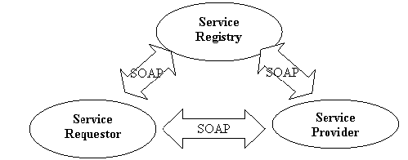
Web services
Web Service: a software system designed to support machine-to-machine interaction over a network. the interface of communication is called WSDL.

Slide 3
What is REST
Representational State Transfer
Architectural Style
Rest Uses HTTP (Request->Response Protocol)

Slide 4
Characteristics of RESTful Protocol
Resource everything is resource
URI every resource has a unique URI
Simple uniform interface for sending state
Request and Response are Representational states
Stateless

Slide 5
HTTP & REST
HTTP | REST
GET | Create
PUT | Create / Update
DELETE | delete
POST | Submits data to the resource

Slide 6
Hello World
create a standard web project with archtype -DarchetypeArtifactId=maven-archetype-webapp
add dependency
<dependency>
<groupId>org.jboss.resteasy</groupId>
<artifactId>resteasy-jaxrs</artifactId>
<version>2.2.1.GA</version>
</dependency>
create a data object say Book{isbn,title}
create a webservice class Library

Slide 7
Get all books
@GET
@Path("/books")
@Produces(MediaType.APPLICATION_JSON)
public List<Book> getBooks() {
List<Book> booksList = new ArrayList<Book>();
booksList.addAll(books.values());
System.out.println("getting books"+booksList);
return booksList;
}

Slide 8
Add Book
@POST
@Path("/books/{isbn}")
@Produces(MediaType.APPLICATION_JSON)
@Consumes(MediaType.TEXT_XML)
public Book addBook(@PathParam("isbn") String id, @QueryParam("title") String title) {
System.out.println("adding book title "+title);
Book e = new Book();
e.setISBN(id);
e.setTitle(title);
books.put(id, e);
System.out.println("has id "+books.containsKey(id));
return e;
}

Slide 9
remove Book
@DELETE
@Path("/books/{isbn}")
@Produces(MediaType.APPLICATION_JSON)
public Book removeBook(@PathParam("isbn") String id) {
System.out.println("deleteing id "+id);
System.out.println(books.containsKey(id));
return books.remove(id);
}

Slide 10
create a class which extends application
@ApplicationPath("/resty")
public class WSApplication extends Application {
deploy on JBOSS and test with RestClient

